Slide 1


Introduction to
Robotic Process Automation
Title of the Project
Your Register No: 220701024
Name:Amallesh.B
Guide:Mrs.J.Jinu Sophia
Designation:Assistant Professor(SG)
Department:Computer Science and Engineering

Slide 2
Abstract
The "Tour Planner" project is an innovative Robotic Process Automation (RPA) solution designed to simplify travel planning. This project leverages UiPath to gather and process key travel information efficiently. Users input their current location and desired tour destination through a dialog box. The system then automates the extraction of relevant information from a static website, including a description of the tour location, details of the top 10 attractions, notable aspects of the destination, and the distance between the current and tour locations. These data extraction processes run concurrently using the Parallel activity, ensuring efficiency and speed. The extracted information is compiled into a text or Word file, converted to PDF format, and sent to the user’s email via the SMTP Mail Message activity. This end-to-end automation significantly reduces manual effort, providing users with a comprehensive travel report in minimal time. The project exemplifies the potential of RPA in enhancing user experience and streamlining routine tasks..

Slide 3
Need for the Proposed System
Automation:
The proposed system automates the travel planning process, eliminating the need for manual research and data compilation. This saves time and reduces human effort.
Efficiency:
By using parallel processing, the system can extract multiple pieces of information (destination details, attractions, distances) simultaneously, making the process faster and more effective.
User Convenience:
The system provides users with a structured, easy-to-read PDF report containing all necessary travel details, delivered directly to their email. This improves user experience and accessibility.
Real-World Applicability:
The proposed system demonstrates practical applications of RPA in the travel industry, making it a valuable tool for businesses or individual users seeking efficient travel planning solutions.
Cost-Effectiveness:
By leveraging RPA, the system minimizes resource usage, as it doesn’t require extensive human intervention or additional tools for data extraction and processing.

Slide 4
Advantages of the Proposed System
The system automates travel planning, saving time and effort with precise and accurate data extraction.
Parallel processing ensures faster execution by handling multiple tasks simultaneously.
Users receive a professional, organized PDF report delivered directly to their email for convenience.
It is cost-effective, scalable, and adaptable to include additional destinations or data points.
The solution integrates automation seamlessly, enhancing user experience and demonstrating the practical application of RPA.

Slide 5
Literature Survey
Paper 1: "Robotic Process Automation in Data Collection and Report Generation"
Advantages:
  Enhances operational efficiency by automating repetitive tasks like data collection and report preparation.
  Reduces human errors in data handling, ensuring accuracy and reliability in the generated reports.
Disadvantages:
  Limited to structured data sources, struggles with unstructured or semi-structured data formats.
  High initial setup cost and time for implementing and configuring RPA workflows
.
Paper 2: "Applications of Web Scraping and Automation in Travel Planning"
Advantages:
  Simplifies the travel planning process by extracting real-time data about destinations and attractions.
  Provides scalability to include additional features like live weather updates or route optimization.
Disadvantages:
  Web scraping is vulnerable to changes in website structure, requiring frequent updates to maintain functionality.
  Ethical concerns regarding scraping websites without explicit permissions, potentially violating terms of service.

Slide 6
Main Objective
The main objective of the "Tour Planner" system is to automate the process of gathering and organizing travel-related information using Robotic Process Automation (RPA). It aims to provide users with accurate and detailed data about their desired tour destination, including descriptions, top attractions, and distances, in a timely and efficient manner. By utilizing parallel processing, the system optimizes the extraction of data from a static website. It compiles the gathered information into a structured format, converts it into a professional PDF report, and delivers it directly to the user via email. The system reduces manual effort, minimizes errors, and enhances user convenience. Additionally, it demonstrates the potential of RPA in real-world applications, particularly in travel planning. The project ensures scalability, efficiency, and user satisfaction by integrating advanced automation technologies into a cohesive workflow.

Slide 7
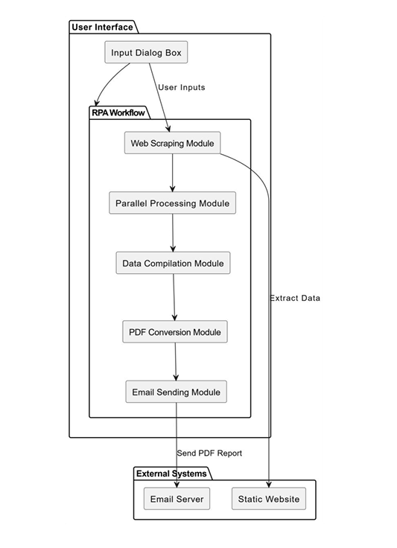
Architecture
Overallstructure

Slide 8
System Requirements
System Requirements for the "Tour Planner" Project
1. Hardware Requirements
Processor: Minimum Dual-Core, 2.5 GHz or higher (Recommended: Quad-Core).
RAM: Minimum 4 GB (Recommended: 8 GB or higher for faster execution).
Storage: At least 500 MB of free space for storing application files and temporary data.
Display: Minimum resolution of 1024x768 pixels.
Network: Stable internet connection for web scraping and email delivery.
2. Software Requirements
Operating System: Windows 10/11, macOS, or Linux (any modern OS that supports RPA tools).
Programming Environment: Python 3.7+ for script development.
Libraries/Packages:
  Selenium (for web scraping).
  PyPDF2 or FPDF (for PDF generation).
  smtplib (for email automation).
RPA Tool: UiPath or any similar automation tool for workflow orchestration.
Browser: Google Chrome, Firefox, or equivalent for web scraping activities.
Email Server: SMTP-compatible server (e.g., Gmail SMTP).

Slide 9
Functional Description
IInput Module: Collects user inputs for current location and desired tour destination through a dialog box.
Web Scraping Module: Extracts destination descriptions, top attractions, and distances from a static website.
Parallel Processing Module: Handles simultaneous data extraction tasks to optimize processing time.
Report Generation Module: Compiles the extracted data into a structured document and converts it into a PDF.
Email Delivery Module: Sends the generated PDF report to the user’s email using an SMTP mail server.

Slide 10
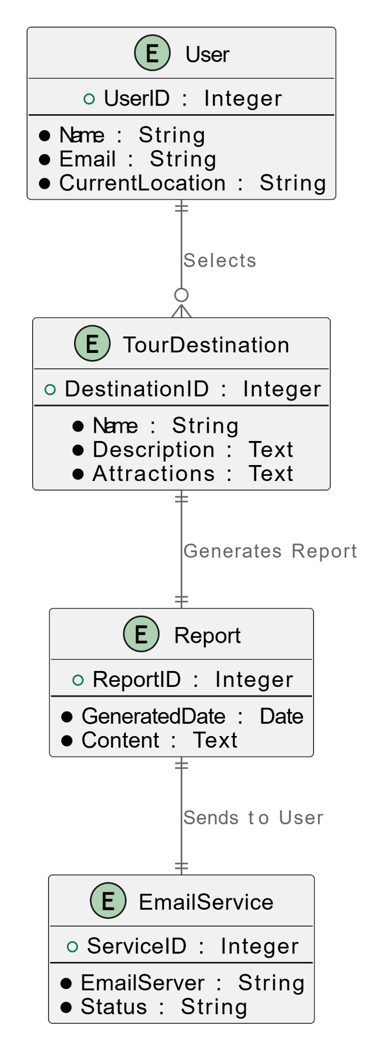
Table Design
ER Diagram

Slide 11
Process Design
Input Collection: The user inputs their current location and desired tour destination through an input dialog box.
Web Scraping: The system navigates to a static website and extracts data such as destination descriptions, top attractions, and distances.
Parallel Processing: All data extraction tasks run simultaneously to optimize processing time and improve efficiency.
Data Compilation: The extracted information is aggregated into a structured format and saved as a text or Word file.
PDF Conversion: The compiled document is converted into a professional PDF report.
Email Delivery: The system sends the generated PDF to the user’s email address using an SMTP mail server.

Slide 12
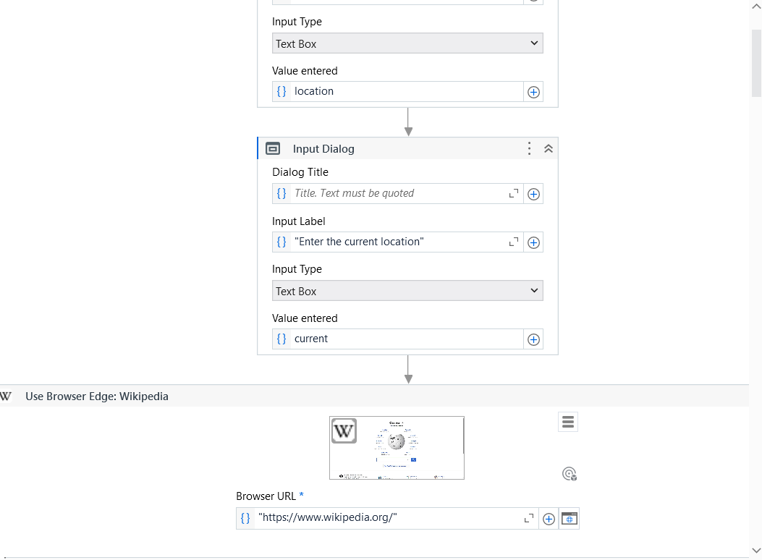
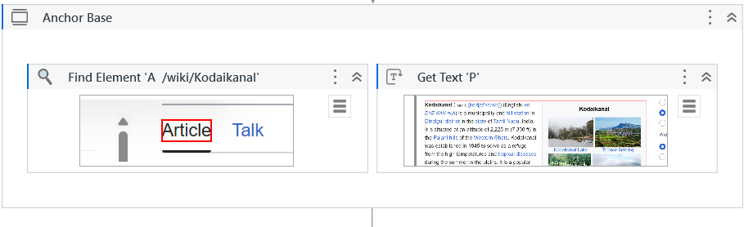
Implementation
Implementation of
user module
Implementation of
data extraction

Slide 13
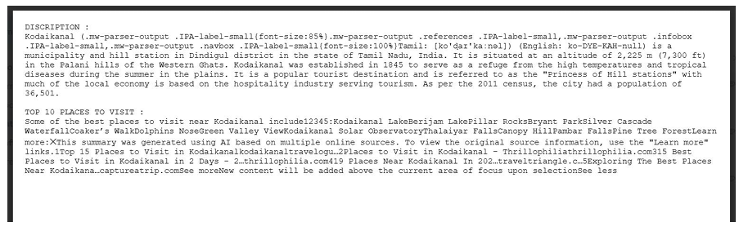
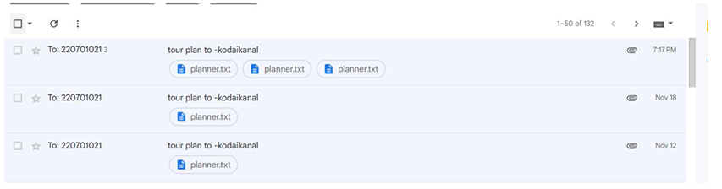
Testing
Sample document
Sample mail

Slide 14
Conclusions
The "Tour Planner" project successfully automates the travel planning process, streamlining the retrieval of crucial destination information and providing users with a detailed, structured travel report. By leveraging UiPath's RPA capabilities, the system efficiently extracts data, runs tasks in parallel, and generates a personalized travel plan in PDF format. This project demonstrates the potential of RPA to improve efficiency and enhance user experience in the tourism domain, eliminating the need for manual data gathering and report creation. With automated email delivery, the solution ensures a seamless, user-friendly process, making travel planning faster and more convenient for users. The "Tour Planner" sets a foundation for further enhancements in automation within the travel and tourism industry, promising greater scalability and ease of use in future iterations.

Slide 15
Future Enhancement
Multi-Destination Planning:
Expand the system to support planning for multiple destinations in a single report, with optimized travel routes and schedules.
Integration with Maps:
Add features for route visualization and distance estimation using APIs like Google Maps.
Voice Input Support:
Enable users to input their locations and preferences via voice commands for a hands-free experience.
Mobile Application:
Develop a mobile app version of the system for easier access and usability on smartphones.
Language Support:
Provide multilingual support to cater to a global audience with diverse language preferences.
Feedback Mechanism:
Include a feedback system to gather user reviews and improve future iterations of the tool.

Slide 16
IEEE Paper
1)"Robotic Process Automation: A Systematic Literature Review and Assessment Framework"
2)"Integration of Artificial Intelligence and Robotic Process Automation: Literature Review and Proposal for a Sustainable Model"
3)"Robotic Process Automation and Consequences for Knowledge Workers: A Mixed-Method Study"

Slide 17
References
1. Avasarala, V. (2019). Robotic Process Automation: The Next Transformation in Digital Transformation. International Journal of Advanced Research in Computer Science, 10(3), 5 12. 2. Lacity, M. C., & Willcocks, L. P. (2016). A Survey on Robotic Process Automation in Business. Journal of Information Technology, 31(2), 174 183. 3. Goudar, R. H., & Soni, M. P. (2017). Automation and Monitoring in Cloud Computing Systems. Journal of Cloud Computing: Advances, Systems, and Applications, 6(1), 23-36.

Slide 18
Queries

Slide 19
Demonstration

Slide 20
Thank You

